Slide 1
Diabetes Surveillance Report, Maine 2012
Slide Set

Slide 2
Chapter 1
Prevalence of Diabetes and Prediabetes

Slide 3
Diabetes Prevention and Control Program
Maine Center for Disease Control and Prevention November, 2012

Slide 4
Diabetes Prevention and Control Program
Maine Center for Disease Control and Prevention November, 2012

Slide 5
Diabetes Prevention and Control Program
Maine Center for Disease Control and Prevention November, 2012

Slide 6
Diabetes Prevention and Control Program
Maine Center for Disease Control and Prevention November, 2012

Slide 7
Diabetes Prevention and Control Program
Maine Center for Disease Control and Prevention November, 2012

Slide 8
Diabetes Prevention and Control Program
Maine Center for Disease Control and Prevention November, 2012

Slide 9
Diabetes Prevention and Control Program
Maine Center for Disease Control and Prevention November, 2012

Slide 10
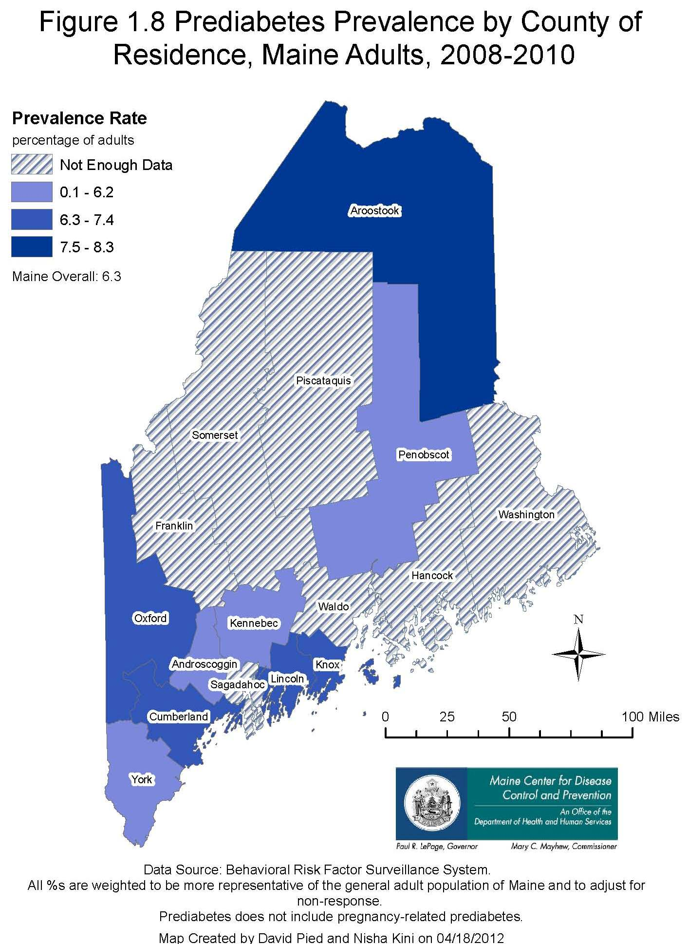
Diabetes Prevention and Control Program
Maine Center for Disease Control and Prevention November, 2012

Slide 11
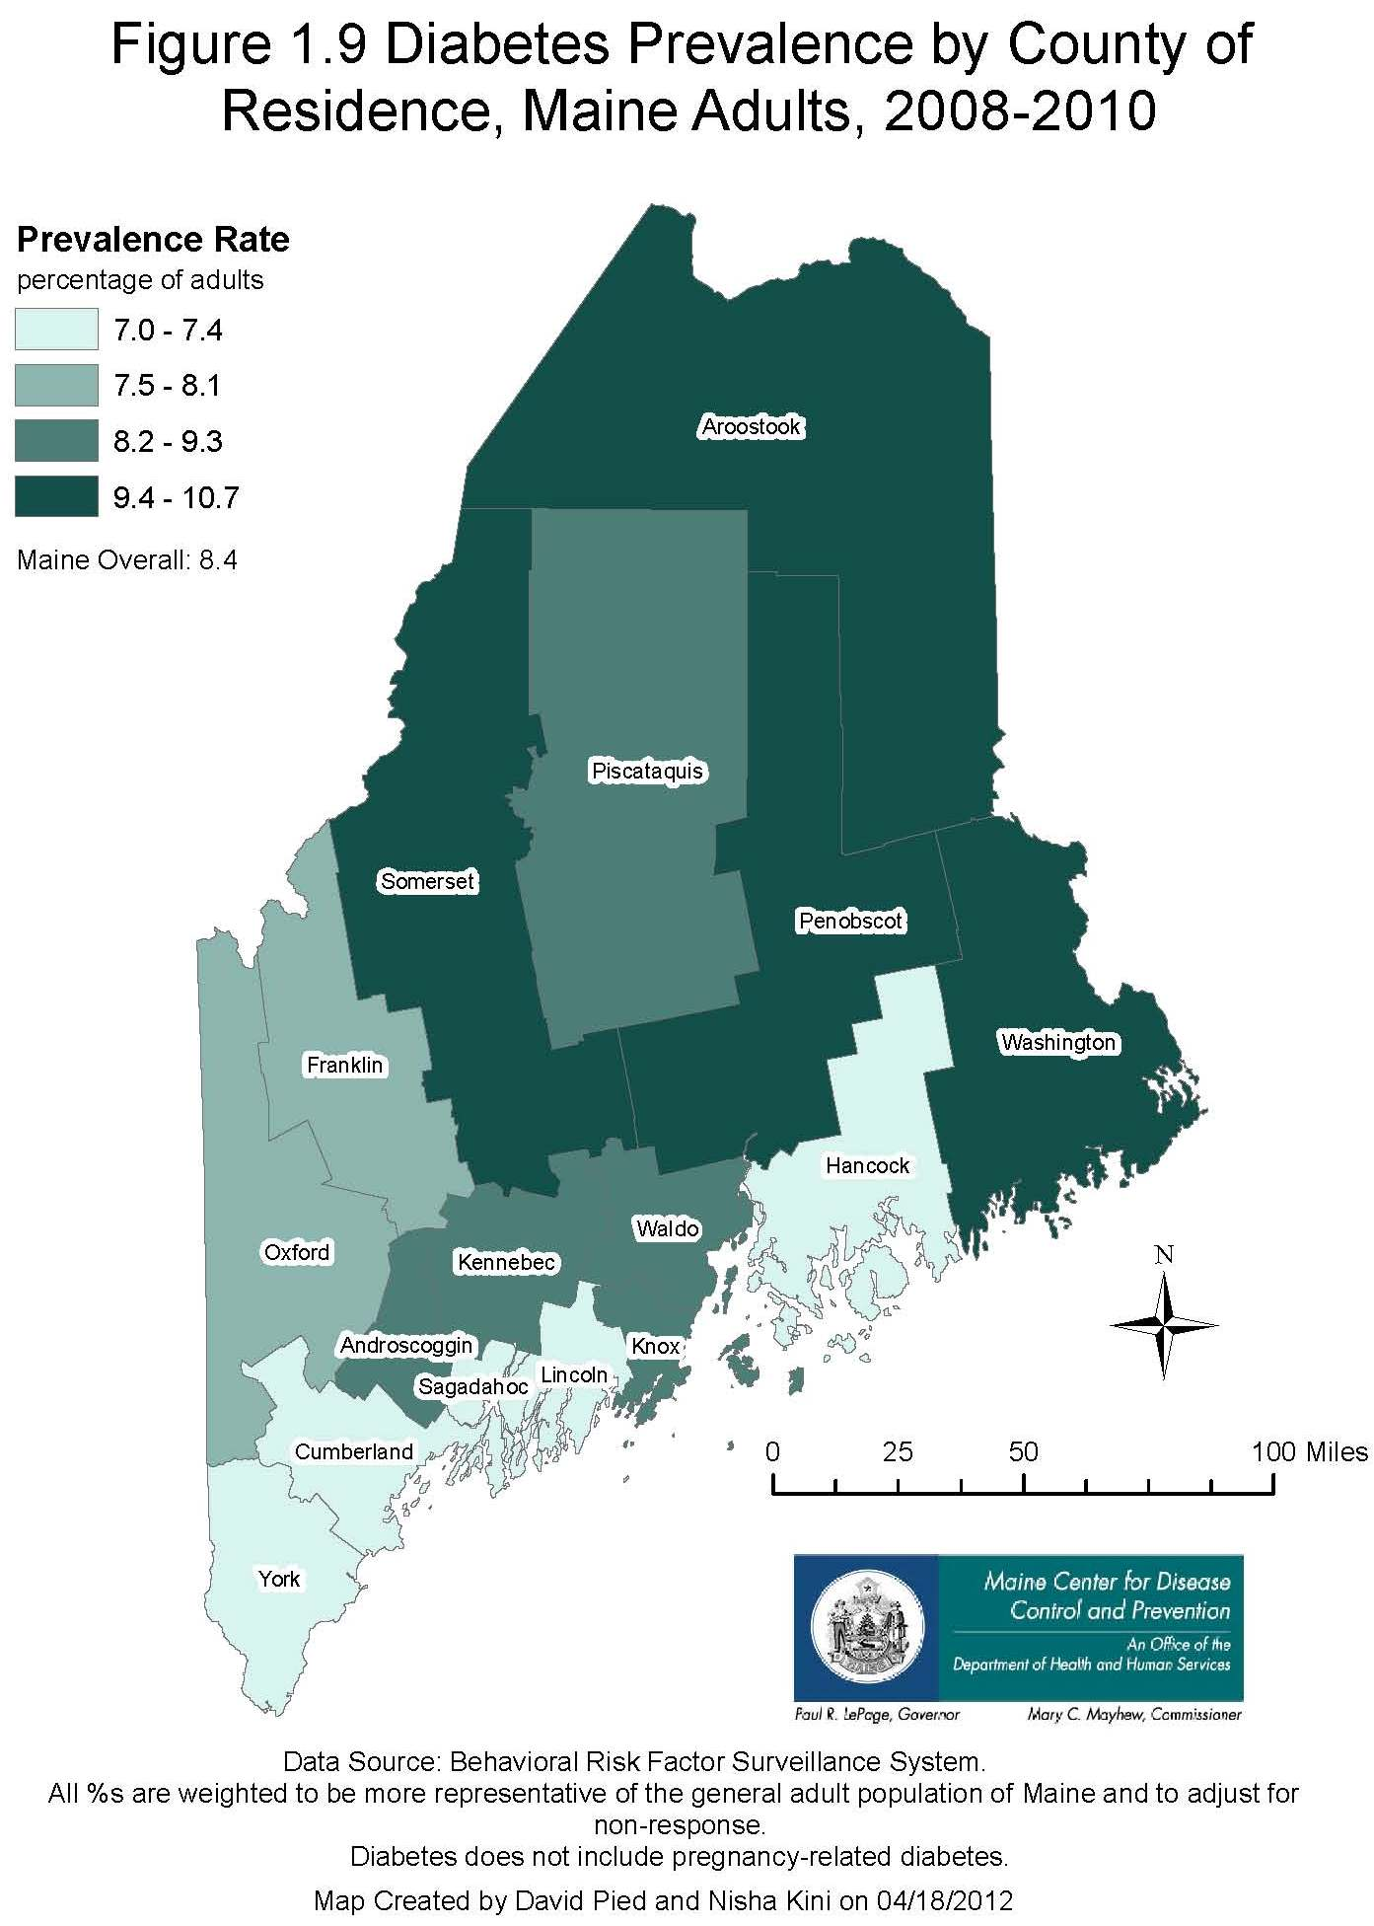
Diabetes Prevention and Control Program
Maine Center for Disease Control and Prevention November, 2012

Slide 12
Chapter 2
Prevalence of Diabetes and Prediabetes by Selected Risk Factors

Slide 13
Diabetes Prevention and Control Program
Maine Center for Disease Control and Prevention November, 2012

Slide 14
Diabetes Prevention and Control Program
Maine Center for Disease Control and Prevention November, 2012

Slide 15
Diabetes Prevention and Control Program
Maine Center for Disease Control and Prevention November, 2012

Slide 16
Diabetes Prevention and Control Program
Maine Center for Disease Control and Prevention November, 2012

Slide 17
Diabetes Prevention and Control Program
Maine Center for Disease Control and Prevention November, 2012

Slide 18
Diabetes Prevention and Control Program
Maine Center for Disease Control and Prevention November, 2012

Slide 19
Diabetes Prevention and Control Program
Maine Center for Disease Control and Prevention November, 2012

Slide 20
Diabetes Prevention and Control Program
Maine Center for Disease Control and Prevention November, 2012

Slide 21
Chapter 3
Diabetes and Diabetes-Related Hospitalizations

Slide 22
Diabetes Prevention and Control Program
Maine Center for Disease Control and Prevention November, 2012

Slide 23
Diabetes Prevention and Control Program
Maine Center for Disease Control and Prevention November, 2012

Slide 24
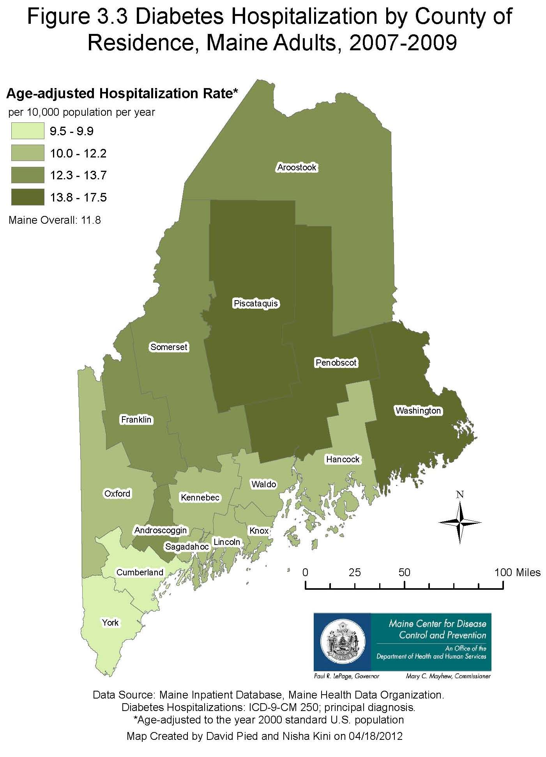
Diabetes Prevention and Control Program
Maine Center for Disease Control and Prevention November, 2012

Slide 25
Diabetes Prevention and Control Program
Maine Center for Disease Control and Prevention November, 2012

Slide 26
Diabetes Prevention and Control Program
Maine Center for Disease Control and Prevention November, 2012

Slide 27
Diabetes Prevention and Control Program
Maine Center for Disease Control and Prevention November, 2012

Slide 28
Diabetes Prevention and Control Program
Maine Center for Disease Control and Prevention November, 2012

Slide 29
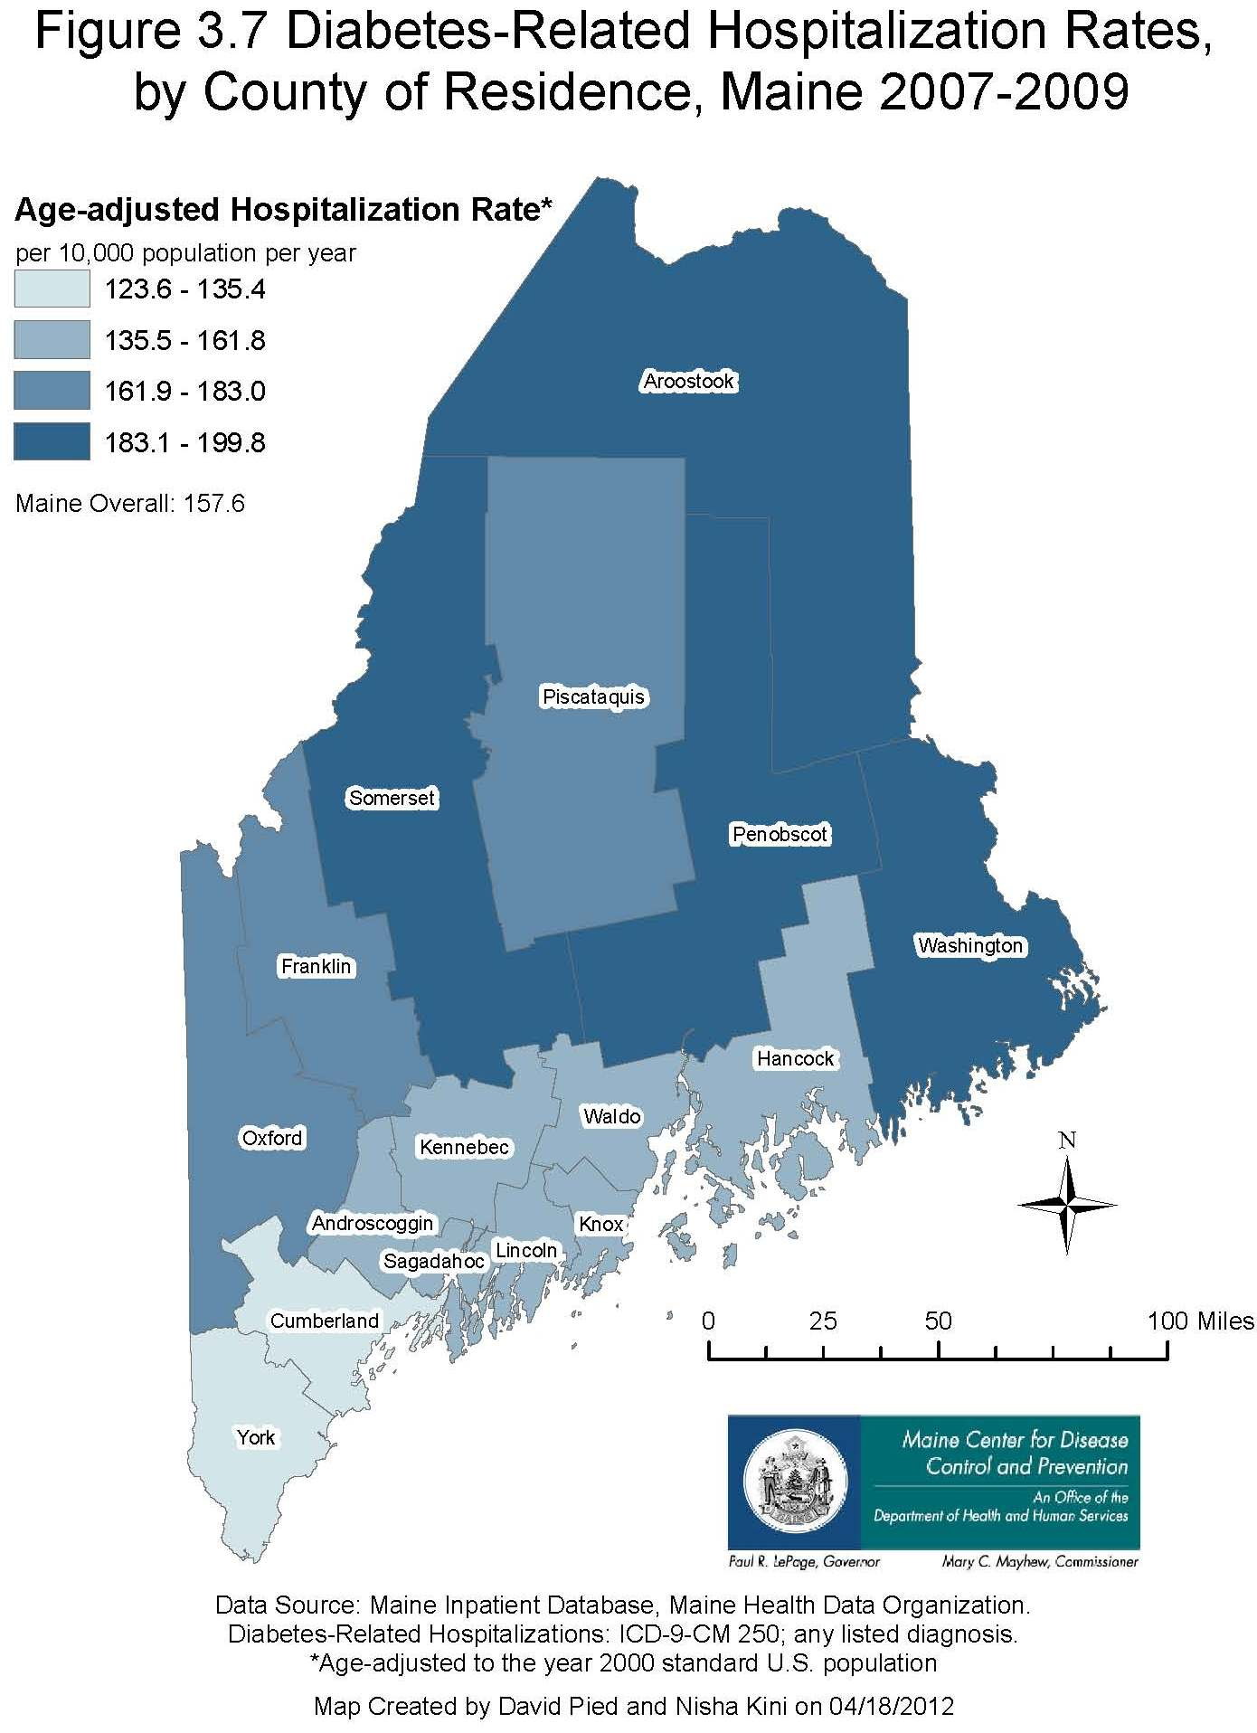
Diabetes Prevention and Control Program
Maine Center for Disease Control and Prevention November, 2012

Slide 30
Diabetes Prevention and Control Program
Maine Center for Disease Control and Prevention November, 2012

Slide 31
Diabetes Prevention and Control Program
Maine Center for Disease Control and Prevention November, 2012

Slide 32
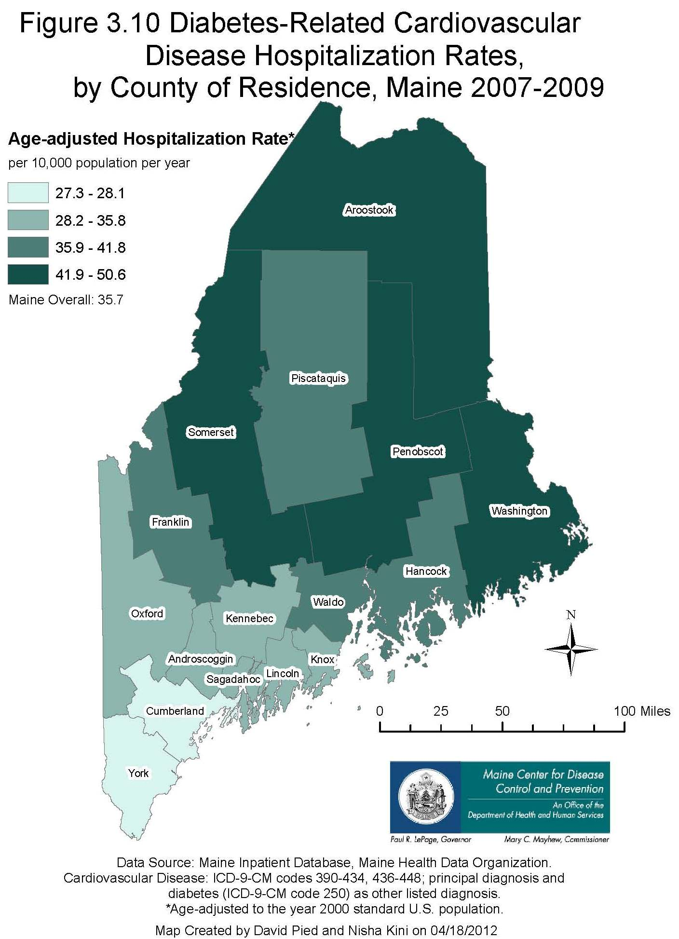
Diabetes Prevention and Control Program
Maine Center for Disease Control and Prevention November, 2012

Slide 33
Diabetes Prevention and Control Program
Maine Center for Disease Control and Prevention November, 2012

Slide 34
Diabetes Prevention and Control Program
Maine Center for Disease Control and Prevention November, 2012

Slide 35
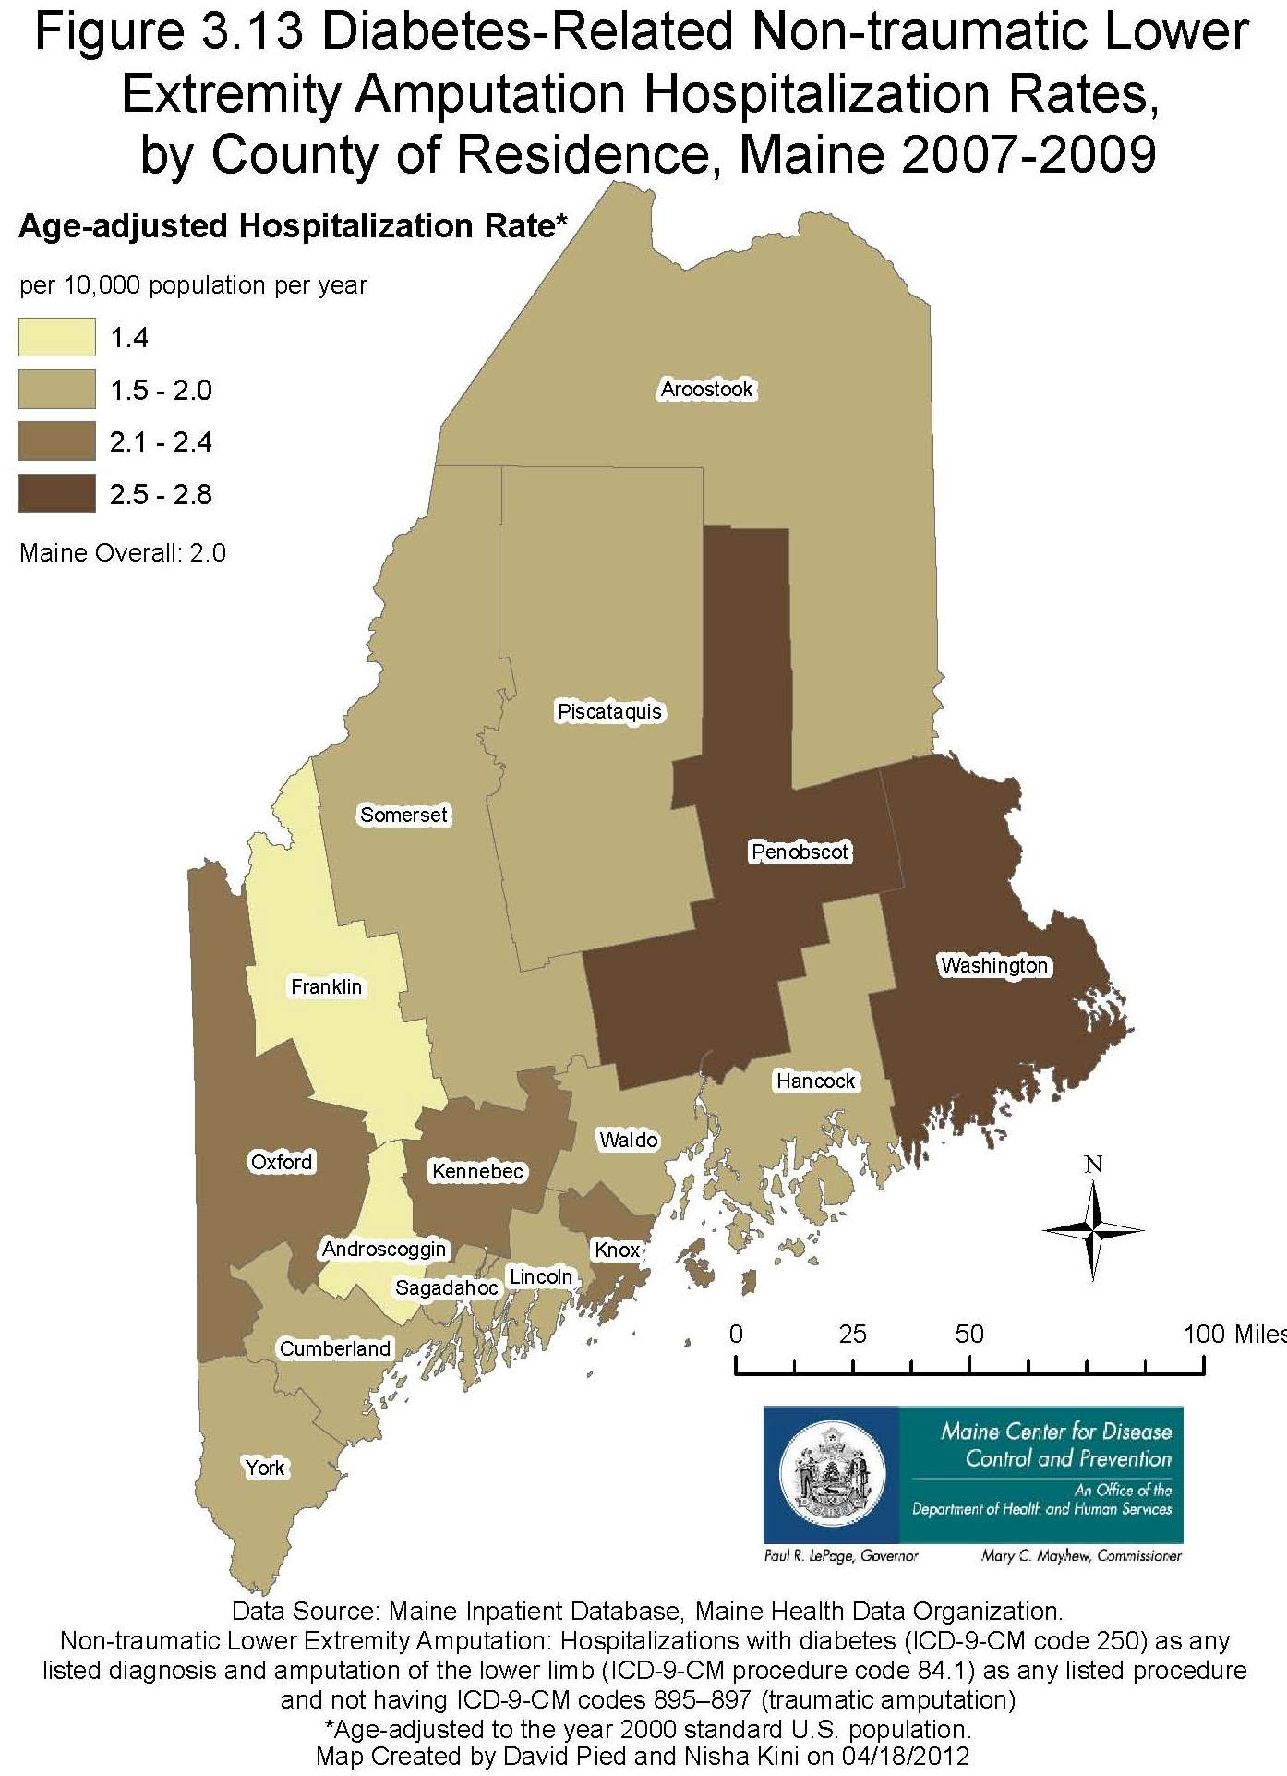
Diabetes Prevention and Control Program
Maine Center for Disease Control and Prevention November, 2012

Slide 36
Chapter 4
Diabetes and Diabetes-Related Death

Slide 37
Diabetes Prevention and Control Program
Maine Center for Disease Control and Prevention November, 2012

Slide 38
Diabetes Prevention and Control Program
Maine Center for Disease Control and Prevention November, 2012

Slide 39
Diabetes Prevention and Control Program
Maine Center for Disease Control and Prevention November, 2012

Slide 40
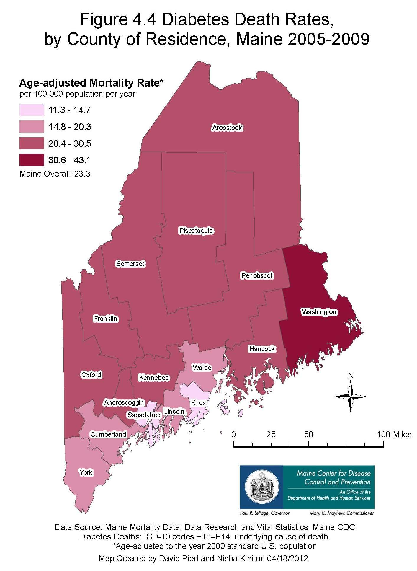
Diabetes Prevention and Control Program
Maine Center for Disease Control and Prevention November, 2012

Slide 41
Diabetes Prevention and Control Program
Maine Center for Disease Control and Prevention November, 2012

Slide 42
Diabetes Prevention and Control Program
Maine Center for Disease Control and Prevention November, 2012

Slide 43
Diabetes Prevention and Control Program
Maine Center for Disease Control and Prevention November, 2012

Slide 44
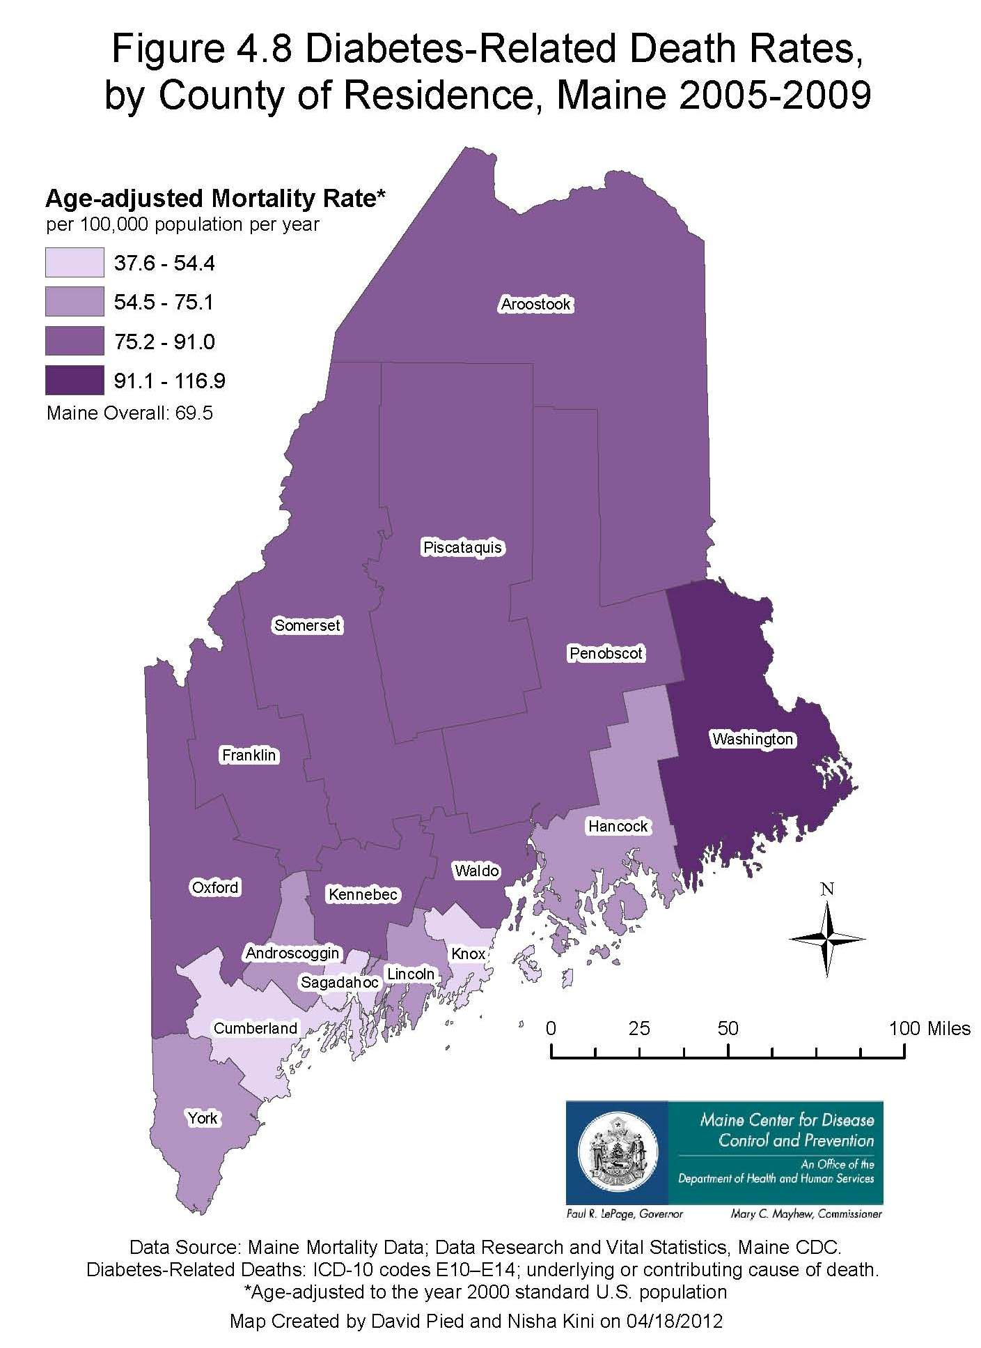
Diabetes Prevention and Control Program
Maine Center for Disease Control and Prevention November, 2012

Slide 45
Diabetes Prevention and Control Program
Maine Center for Disease Control and Prevention November, 2012

Slide 46
Diabetes Prevention and Control Program
Maine Center for Disease Control and Prevention November, 2012

Slide 47
Diabetes Prevention and Control Program
Maine Center for Disease Control and Prevention November, 2012

Slide 48
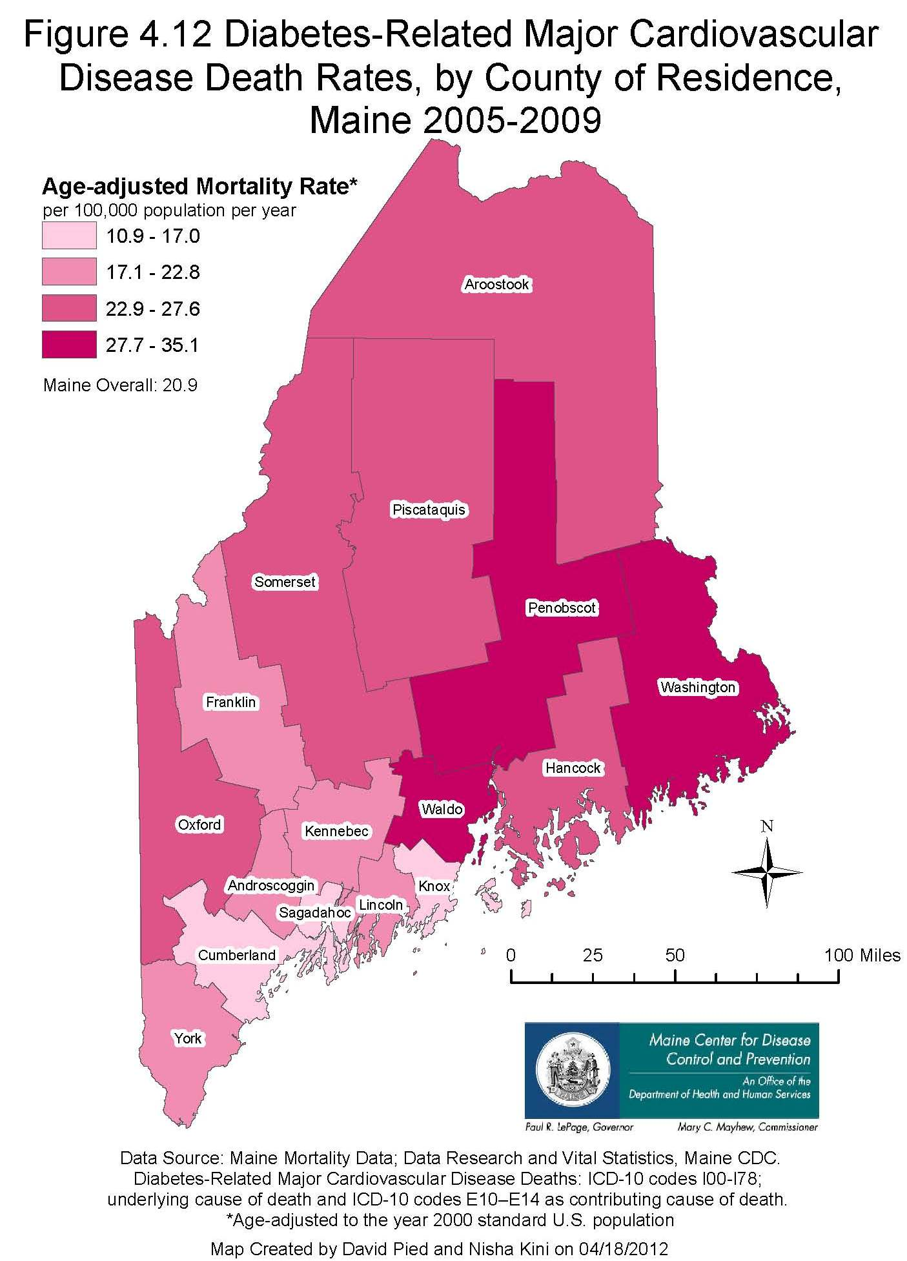
Diabetes Prevention and Control Program
Maine Center for Disease Control and Prevention November, 2012

Slide 49
Chapter 5
Healthy Maine 2010 Milestones Achieved and Healthy Maine 2020 Objectives

Slide 50
There are no figures for Chapter 5

Slide 51
Chapter 6
Preventive Practices among Maine Adults with Diabetes

Slide 52
Diabetes Prevention and Control Program
Maine Center for Disease Control and Prevention November, 2012

